Slide 1

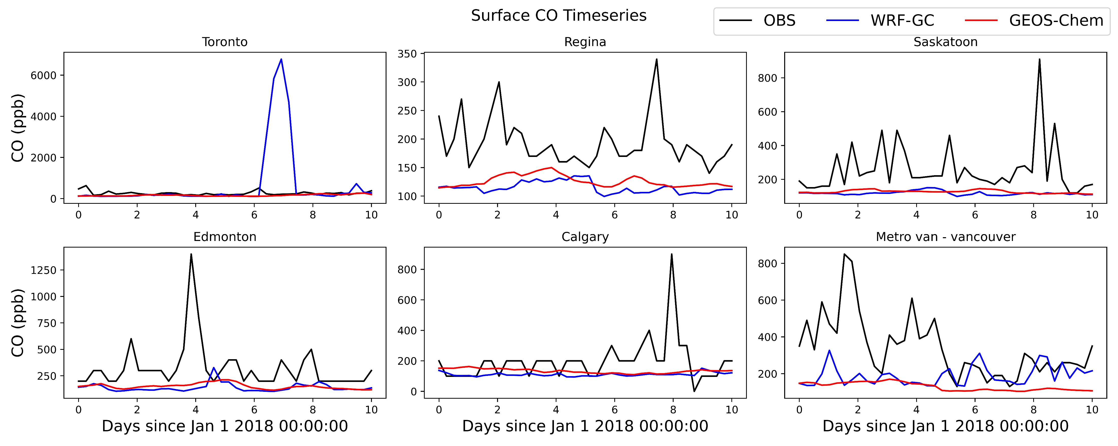
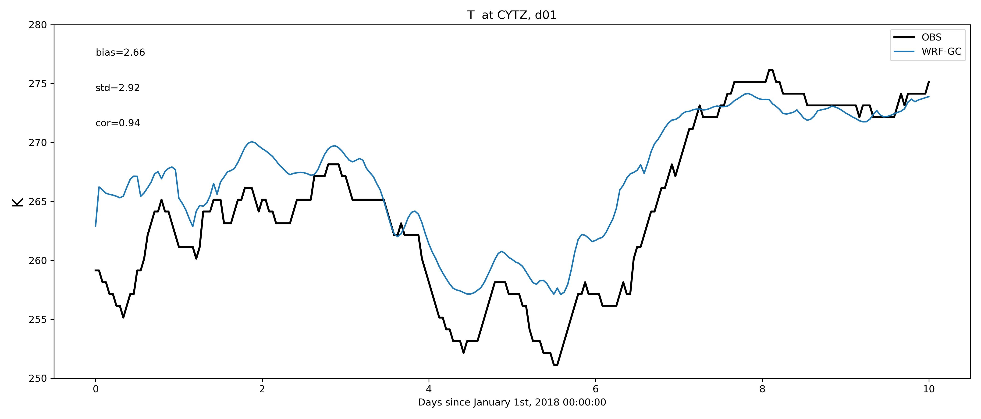
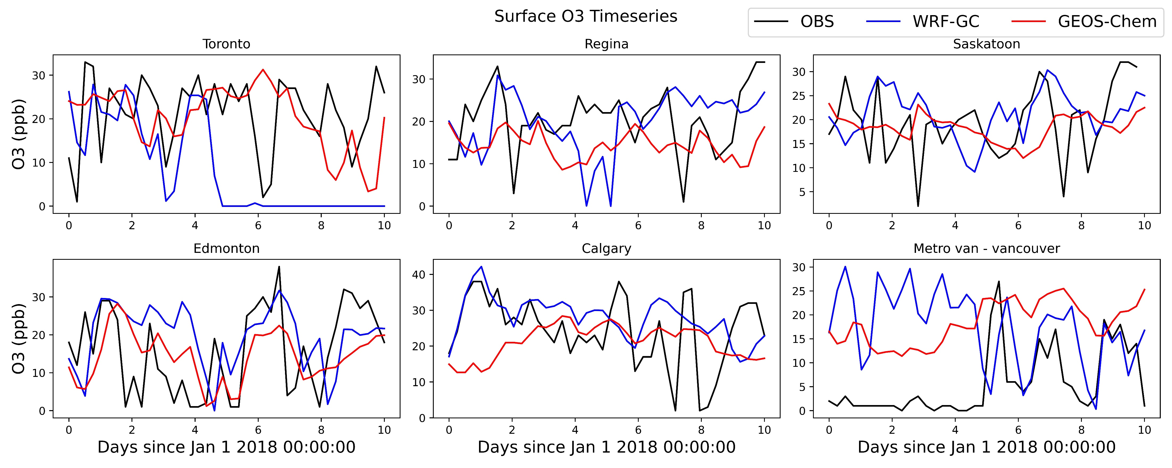
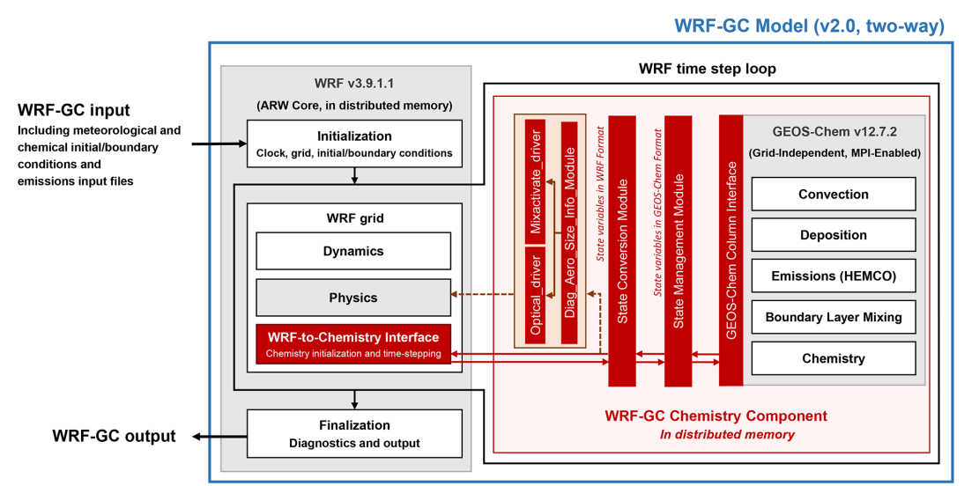
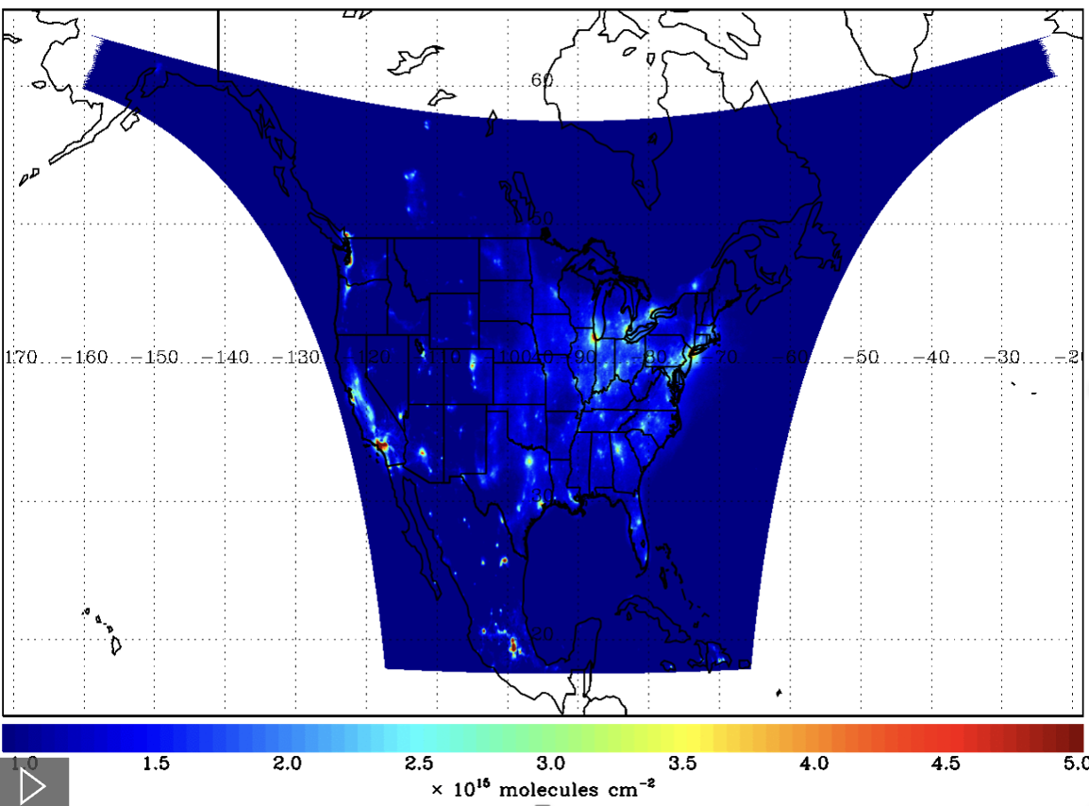
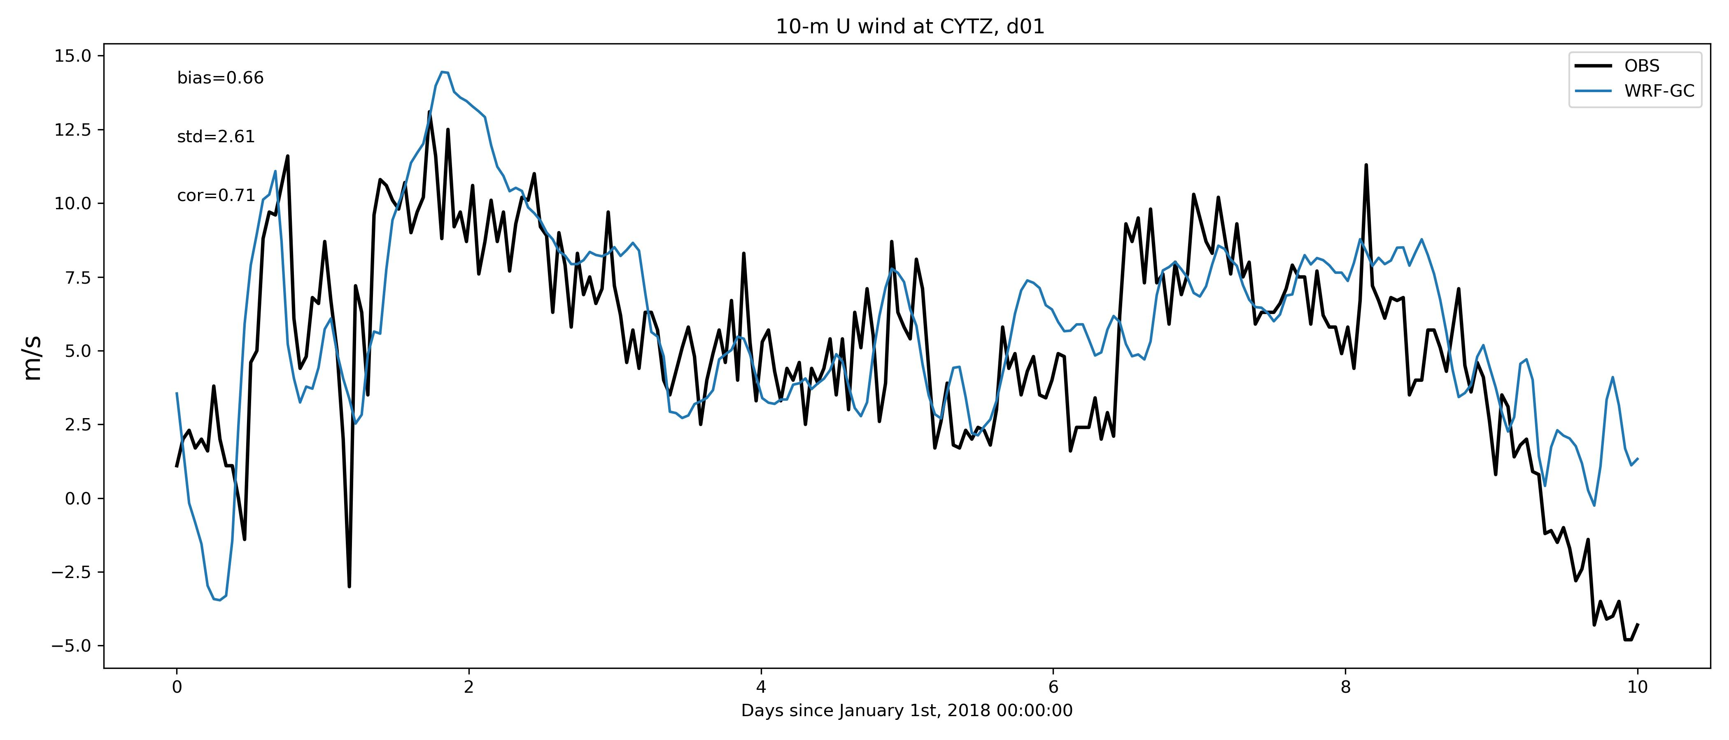
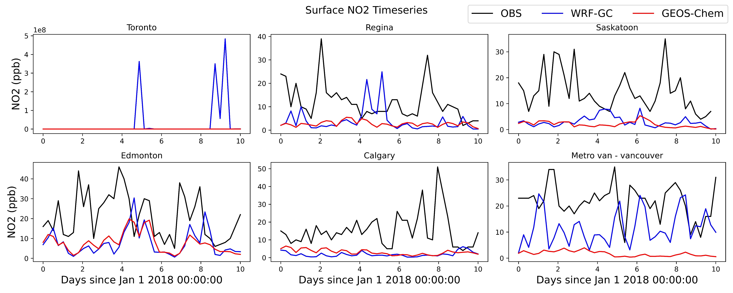
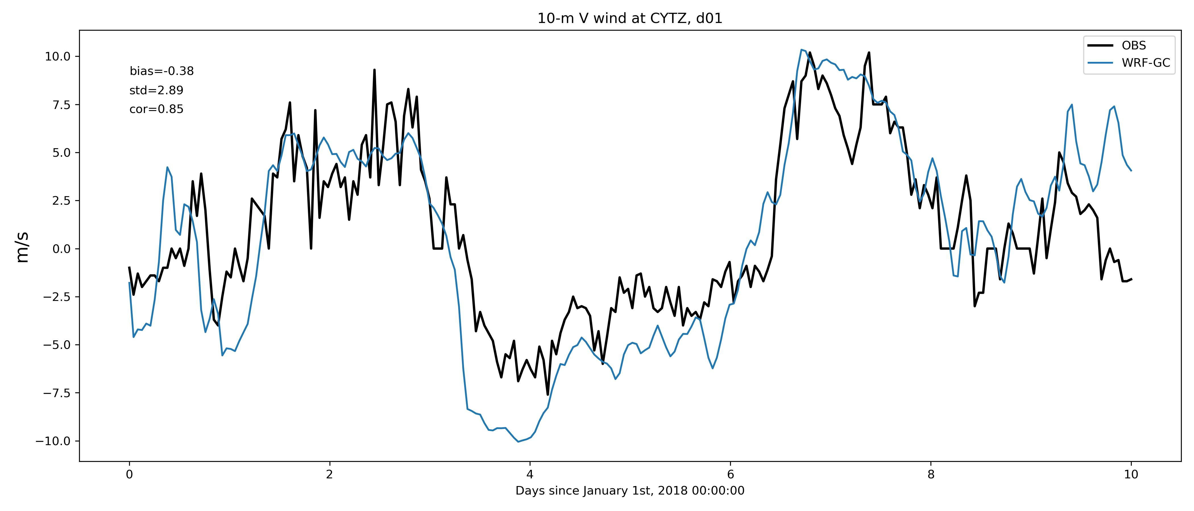
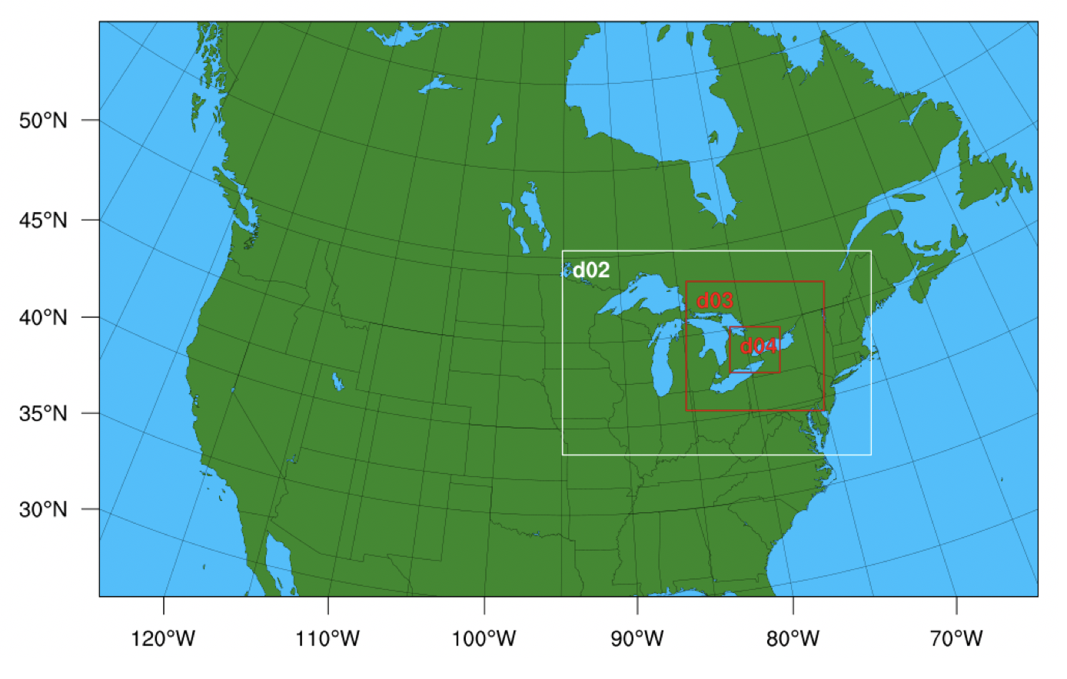
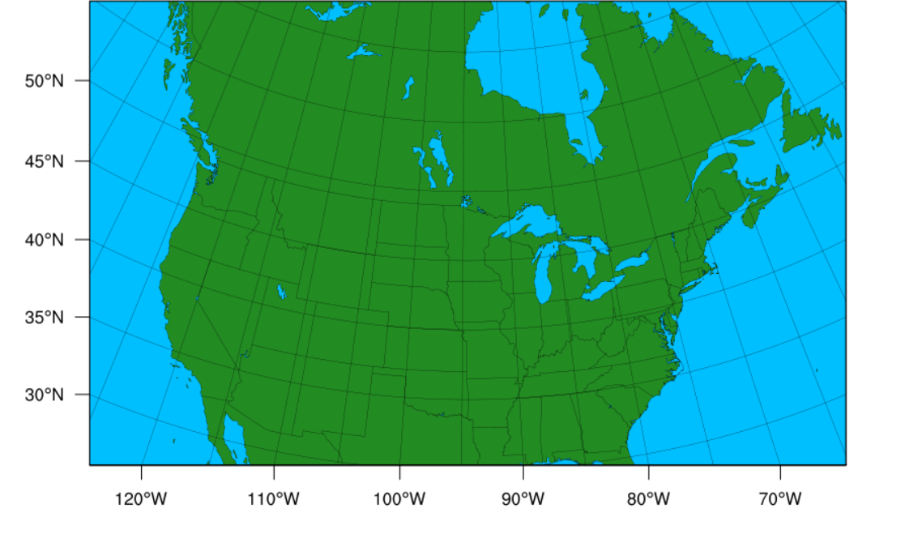
Modelling Atmospheric Chemistry Transport with WRF GEOS-Chem
Lucas Prates, Dylan Jones, Jinwoong Kim, and Zixuan Xiao
Department of Physics, University of Toronto
Background
Motivation
Results
Atmospheric chemistry transport models simulate the time evolution of atmospheric constituents such as trace gasses and particulate matter. These models can be split into two broad categories based on their handling meteorological variables.
Offline models use archived meteorological fields to drive the transport of chemical species.
Online models make use of a dynamical solver to generate meteorological variables alongside the chemical variables. This makes online models more flexible than offline models as they are not limited by the resolution and time span of pre-existing meteorological data.
In April 2023, NASA’s TEMPO (Tropospheric Emissions: Monitoring Pollutions) instrument was launched into geosynchronous orbit over the Americas. TEMPO will collect hourly observations of O₃, NO₂, and other air quality gases across North America. The long-term motivation of using WRF-GC is to run the model at resolution comparable to TEMPO and assimilate TEMPO’s observations with the model output. The assimilated data can then be used to study air quality in Toronto and other urban regions going forward.
To evaluate the WRF-GC chemistry output, we compared the surface level CO, O₃, and NO₂ timeseries at several locations across Canada. The output form WRF-GC was plotted (see Figure 4) alongside both the GEOS-Chem 4° x 5° output and observation data from NAPS (National Air Pollution Surveillance Program).
Figure 1. Schematic of the coupling between WRF and GEOS-Chem. From Feng et al. (2021).
Figure 3. TEMPO’s hourly field of view. Figure courtesy of Xiong Liu.
WRF-GC is an online regional atmospheric chemistry transport model. Specifically, WRF-GC is a coupling of the Weather Research and Forecasting Model (WRF) and the offline regional atmospheric chemistry transport model, GEOS-Chem. WRF-GC (see Figure 1) uses WRF’s dynamical solver and grid system to generate the meteorological fields, which then drive the GEOS-Chem chemical processes: convective transport, wet/dry deposition, chemical emissions, boundary layer mixing, and chemistry.
The focus of this project was to port WRF-GC to the Niagara supercomputer on SciNet, with the following objectives:
Identify what problems / difficulties might we encounter running WRF-GC on Niagara,
Determine how WRF’s dynamics impact the GEOS-Chem tracer distribution,
Figure 4. Comparison of WRF-GC and GEOS-Chem CO (top two rows), O₃ (middle two rows), and NO₂ (bottom two rows) with NAPS data. Both GEOS-Chem and WRF-GC tended to underestimate CO and NO₂ concentrations across sampled locations. Additionally, WRF-GC resulted in unphysical behaviour for all three species in Toronto and other locations on the East Coast.
Figure 5. Evaluation of the meteorological variables from WRF-GC in Toronto with surface observations from NCEP. This comparison resulted in correlations of 0.94, 0.71, and 0.85 for surface temperature, 10 m u-wind, and 10 m v-wind, respectively, between model output and observations.
Methodology
Conclusions
Future Work
For this project, I ran WRF-GC at a 27 km x 27 km resolution with 40 pressure levels, from January 1st, 2018, to January 10th, 2018. The domain, encompassing most of North America, is shown in Figure 2 below.
Atmospheric chemical reactions are highly driven by energy from the Sun so winters are less chemically active than summers. Therefore, running a simulation in the winter minimizes the production and loss of chemical species. I chose to run my simulations in the winter so that the differences between WRF-GC and GEOS-Chem will be predominantly driven by the dynamics of each model.
The initial and boundary conditions for the meteorological variables were provided by North American Regional Reanalysis (NARR) fields.
The initial and boundary conditions for the chemical variables were generated from a global GEOS-Chem run, at 4° x 5° resolution. The data is available at 6 hourly intervals. For this GEOS-Chem run, a two month spin up time was included. This is an additional two months of running before the beginning of the simulation period, which is required for the model to move away from the initial conditions and resolve any unphysical structures present in the initial state. The GEOS-Chem run was driven by MERRA-2 meteorology.
The WRF winds and temperatures are consistent with NCEP observations, but there is an issue with the interaction between the WRF dynamics and the GEOS-Chem chemistry in eastern Canada.
The failure of both WRF-GC and GEOS-Chem to accurately represent the chemical data may be due to the short spin-up period used in GEOS-Chem. While two months is a typical spin-up time for summer simulations, wintertime’s longer chemical lifetimes may cause the unphysical structures from the initial state to last longer. These structures may be causing an imbalance between the dynamics and chemistry in the model.
Future goals include:
Increase the spin-up time to four months.
Increase the resolution of the chemical initial and boundary conditions to 2° x 2.5°.
Make use of WRF’s domain nesting feature to increase the model resolution up to 1 km x 1 km in the Toronto area.
Figure 6. Nested domain for future work over Toronto.
References
Feng, X., Lin, H., Fu, T.-M., Sulprizio, M. P., Zhuang, J., Jacob, D. J., Tian, H., Ma, Y., Zhang, L., Wang, X., Chen, Q., and Han, Z.: WRF-GC (v2.0): online two-way coupling of WRF (v3.9.1.1) and GEOS-Chem (v12.7.2) for modeling regional atmospheric chemistry–meteorology interactions, Geosci. Model Dev., 14, 3741–3768, https://doi.org/10.5194/gmd-14-3741-2021, 2021.
National Centers for Environmental Prediction/National Weather Service/NOAA/U.S. Department of Commerce. 2005, updated monthly. NCEP North American Regional Reanalysis (NARR). Research Data Archive at the National Center for Atmospheric Research, Computational and Information Systems Laboratory. https://rda.ucar.edu/datasets/ds608.0/.5.
Environment and Climate Change Canada. National Air Pollution Surveillance Program (NAPS) – Hourly Air Quality Data. https://data.ec.gc.ca/data/air/monitor/national-air-pollution-surveillance-naps-program/Data-Donnees/2018/ContinuousData-DonneesContinu/HourlyData-DonneesHoraires/?lang=en.
Figure 2. North American domain used for the WRF-GC simulation.

